Slide 1
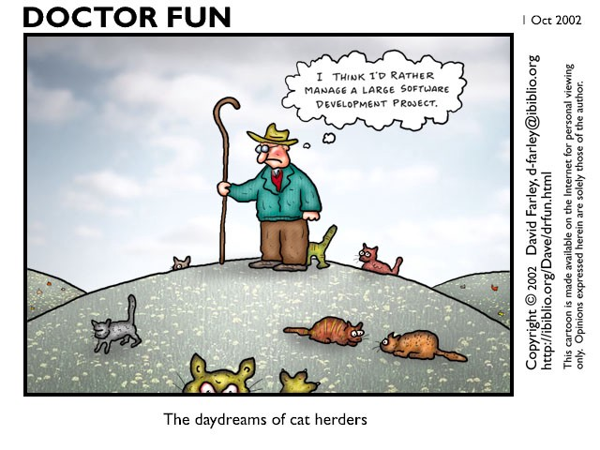
ag·ile ag·ile /ˈajəl/
A simplified presentation on the Scrum-agile approach to product development
By Kate Mundale

Slide 2
Agile scrum methodology is a sprint-based project management system with the goal of delivering the highest value to stakeholders.
AGILE PRINCIPLES
SCRUM VALUES & PRINCIPLES
Customer satisfaction
Regulation, reflection, and adjustment
Courage
Process control
Face-to-face conversation
Respect
Embrace change
Early and continuous delivery
Openness
Commitment
Simplicity
Self-organization
Functional products
Frequent delivery
Technical excellence
Value-based prioritization
Focus
Collaboration of businesses and developers
Motivated individuals
Collaboration

Slide 3






AGILE SCRUM WORKFLOW
SPRINT RETROSPECTIVE
PRODUCT BACKLOG
WHAT WENT WELL?
WHAT CAN BE IMPROVED FOR THE NEXT SPRINT?
SPRINT REVIEW
DAILY SCRUM
SPRINT PLANNING
REQUIREMENTS DIVIDED INTO STORIES
SPRINT BLOCKING
LIST OF INTERNAL
AND EXTERNAL THINGS THAT WILL IMPEDE PROGRESS
WHAT WAS COMPLETED?
WHAT NEEDS TO BE DONE?
WHAT TO DO NEXT?
HAS ANYTHING CHANGED?
REVIEW TIMELINE AND BUDGET
LIST OF USER REQUIREMENTS
REQUIREMENT
REQUIREMENT
REQUIREMENT
REQUIREMENT
REQUIREMENT
REQUIREMENT
REQUIREMENT
WHAT DID
I DO YESTERDAY?
WHAT WILL I DO TODAY?
WHAT WILL IMPEDE ME?
USER STORY 1
REQUIREMENT
REQUIREMENT
SCRUM TEAM
INTERNAL
BLOCKER
BLOCKER
USER STORY 2
REQUIREMENT
REQUIREMENT
REQUIREMENT
SCRUM MASTER
EXTERNAL
BLOCKER
BLOCKER
PRODUCT
OWNER
TESTER
USER STORY 3
REQUIREMENT
REQUIREMENT
DEVELOPER
DEVELOPER
DEVELOPER

Slide 4




WHO’S ON THE TEAM?
TESTER
SCRUM MASTER
Find bugs and defects in project by frequently running tests after every change
Automate specifications for Behavior Driven Development
Business-facing testing
Technology-facing testing
Facilitate communication between Product Owner and dev team
Facilitating all Scrum events
Introduce Agile Engineering Practices
Coaching all team members, removing impediments
Assist the Product Owner With the Product Backlog
PRODUCT OWNER
DEVELOPERS
Physically write the code and build the product by completing user stories within each sprint
Practice open communication for complete transparency with team members
Practice Test Driven Development
Manages and prioritizes work in the product backlog
Stays informed on the market for the customer’s needs
Serves as liaison between the dev team and client
Maintains availability to dev team to answer questions

Slide 5
Waterfall Methodology is a project management approach that emphasizes a linear progression from the beginning to the end of a project.
DESIGN
Lay out a thorough plan
Waterfall methodology relies on being able to plan out the entire project before you begin, foreseeing any roadblocks or challenges that may come up
Essential in some industries, best for projects with a clear and fixed end goal
Great for projects that require intense review and a high level of reliability
REQUIREMENTS
Gather all resources needed to complete project
IMPLEMENTATION
Project build
Allows for little to no flexibility, so deadlines and a hard budget can be set at the beginning of the project
Transfers information well from one phase to the next. As each phase is completed thorough documentation can be provided for the work done
Keep the project on a set timeline through each phase
VERIFICATION / TESTING
Upon build completion, test for errors, bugs & issues
DEPLOYMENT & MAINTENANCE
Deliver the product to the customer and help maintain the work

Slide 6
AGILE SCRUM
WATERFALL
VS
In Software/Application Development
Workflow is designed to handle challenges, changes, and sudden pivots
The client is involved often throughout project development, increasing trust and satisfaction
Frequent testing catches unforeseen issues and problems early in development
Ultimately saves time and money through total team transparency and regular reviews.
Not flexible, does not support making changes or unforeseen challenges. Sudden pivots or vision changes may lead to extensive rework
This methodology has very little client input, aside from the initial design phase. The client does not see the product again until delivery
In waterfall workflow, testing is delayed until the project is completed. Major bugs can be missed that might have been easily fixed earlier on

Slide 7
SCRUM AGILE OVER WATERFALL
FLEXIBILITY
Ability to pivot, make major feature changes, and even abandon features mid-project without majorly impacting the rest of the body of work
TEAMWORK
The transparency, openness, and team-centered principles allow for the entire Scrum team to work efficiently and with less stress.
DELIVERY
Working in sprints allows the team to deliver a product at regular intervals, giving the team a sense of accomplishment and building trust and report with the customer.

Slide 8
SOURCES
Beck K, Beedle M, van Bennekum A, Cockburn A, Cunningham W, Fowler M, Greening J, Highsmith J, Hunt A, Jefferies R, Kern J, Marick B, Martin R, Mellor S, Schwaber K, Sutherland J, Thomas D. Agile Manifesto. 2001. Accessed October 15, 2022. https://agilemanifesto.org/
The Scrum Team Roles and Accountabilities: Scrum Fundamentals. ScrumAlliance. Updated 2022. Accessed October 15, 2022. https://resources.scrumalliance.org/Article/scrum-team
What is a Product Backlog? Scrum.org. Accessed October 15, 2022. https://www.scrum.org/resources/what-is-a-product-backlog
Hoory Leeron, Bottorff Cassie. What Is Waterfall Methodology? Here’s How It Can Help Your Project Management Strategy. Forbes Advisor. Updated March 25, 2022. Accessed October 15, 2022. https://www.forbes.com/advisor/business/what-is-waterfall-methodology/
Charles G. Cobb. The Project Manager’s Guide to Mastering Agile : Principles and Practices for an Adaptive Approach. Wiley; 2015. Accessed October 18, 2022. https://search-ebscohost-com.ezproxy.snhu.edu/login.aspx?direct=true&db=nlebk&AN=937009&site=ehost-live
Animations by Kate Mundale, October 2022.

